Slide 1
INFORMATION TECHNOLOGY
(ICITSS)
BATCH NO- , CIRC, KANPUR
By:-
PRADEEP KUMAR GUPTA
F.CA , DISA(ICAI), Insurance Surveyor and Loss assessor

Slide 2
About Faculty :-
CA Pradeep Kumar Gupta
More than 9 years of diverse industries experience in all areas of Audit, Investigation, Due Diligence, Taxation (Direct and Indirect), and Company Law Matters for both domestic and foreign companies, Management Consultancy, Information System Audit and FEMA.
Well geared to take up any professional assignments in the above areas. It has association with firms of Chartered Accountants, Management Consultants, Company Secretaries and I T Professionals etc.
Work with clientele includes companies (large and medium sized), firms, banks, trusts, societies, charitable and educational institutions besides few renowned individuals.
He has been part of following trainings and has completed following courses:
All India Rank -38 in CA IPC
Certification of “Diploma in Information System Audit (DISA)” from ICAI.
Certification of Concurrent Audit of Banks from ICAI.
Certificate Course on Valuation from ICAI.
Insurance Surveyor and loss assessor by IRDA.
Licentiate member of IIISLA.

Slide 3
Syllabus to be covered
UNIT – 5
Computer Assisted Audit Techniques
(18 Hours)

Slide 4
Unit 5 : Computer Assisted Audit Techniques
Chapter 1 : Introduction to CAAT
Chapter 2 : Data Analysis and Audit Techniques
Chapter 3 : Data Analysis using IDEA
Chapter 4 : Advanced Analytics using IDEA

Slide 5
Session agenda
What Why and When ?
How :Steps to be followed
Key Features and examples
Use of Excel As CAAT
Use of IDEA software

Slide 6
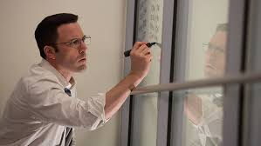
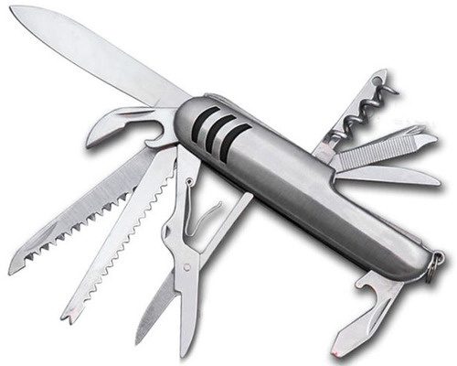
What Why & When ?

Slide 7
What is CAAts?
Also refered as CAATS
Computer Assisted Audit techniques
Data Analysis Tool For Audit
Ease of Use of Excel But Power of Database.
General Audit Software
Analytical Tool For Auditor
CAATS is Concept Not Software
Computer Software is Used as an aid to Audit

Slide 8
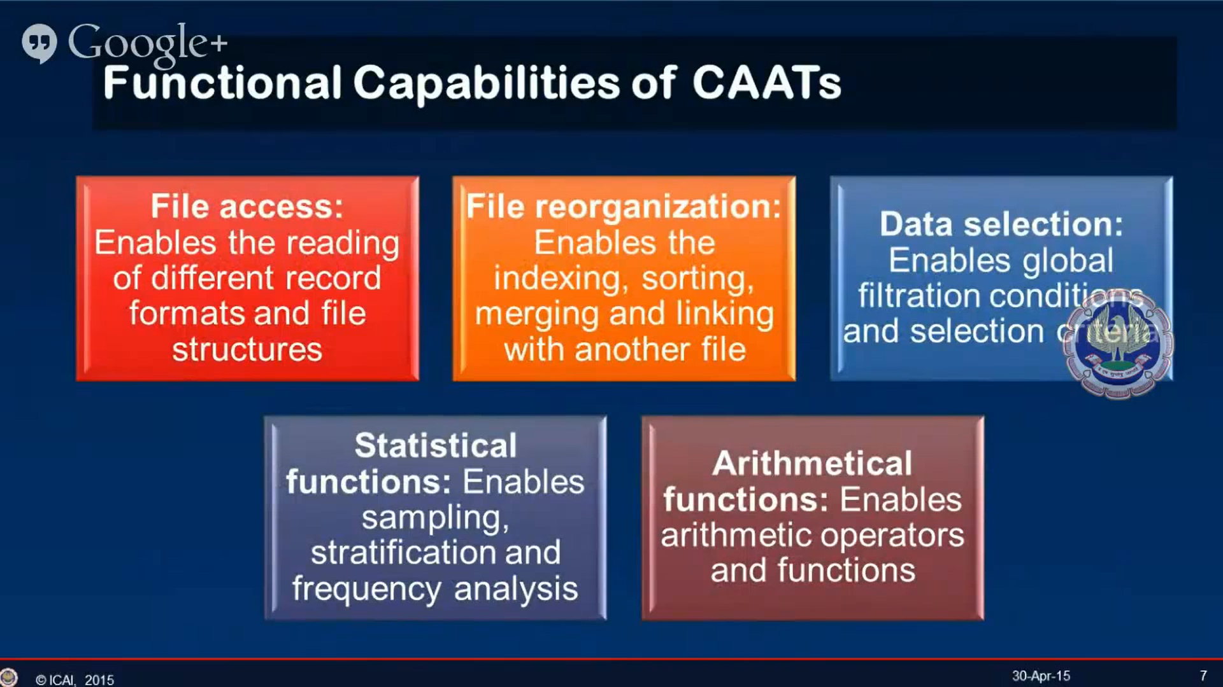

Slide 9
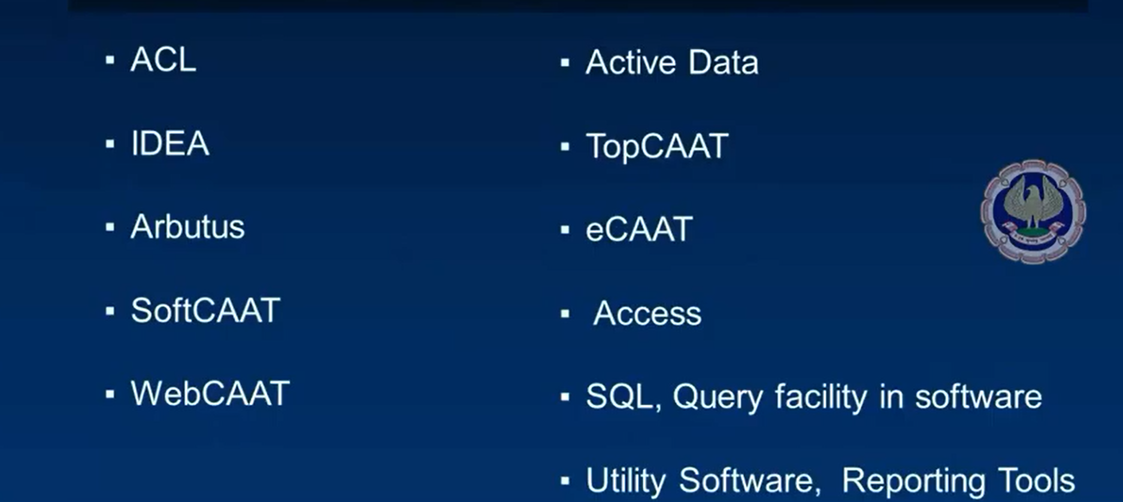
Some Example of CAATS

Slide 10
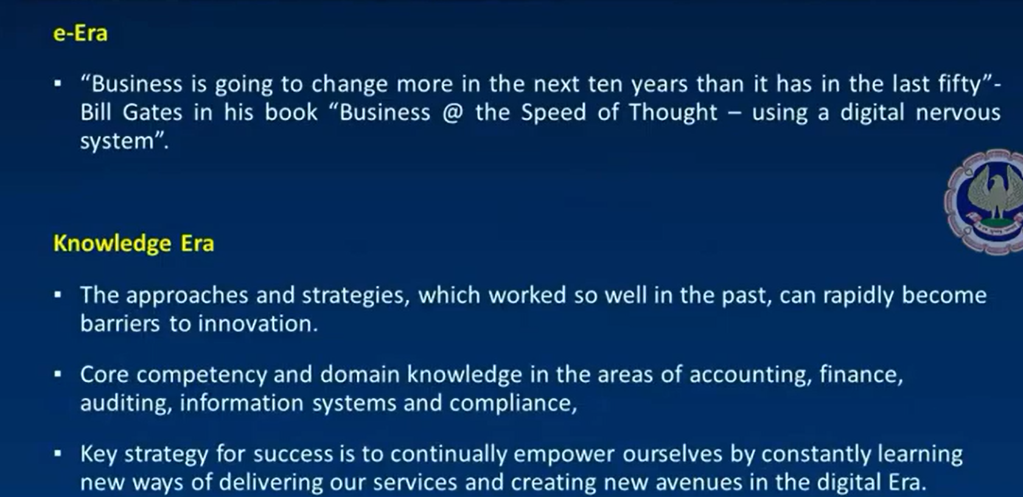
Why CAATs?

Slide 11

THE ALL-ENCOMPASSING ELECTRONIC DATA
The question “do I need to use technology” is no
longer relevant instead the relevant decision is about “how do I use technology to remain relevant”.

Slide 12
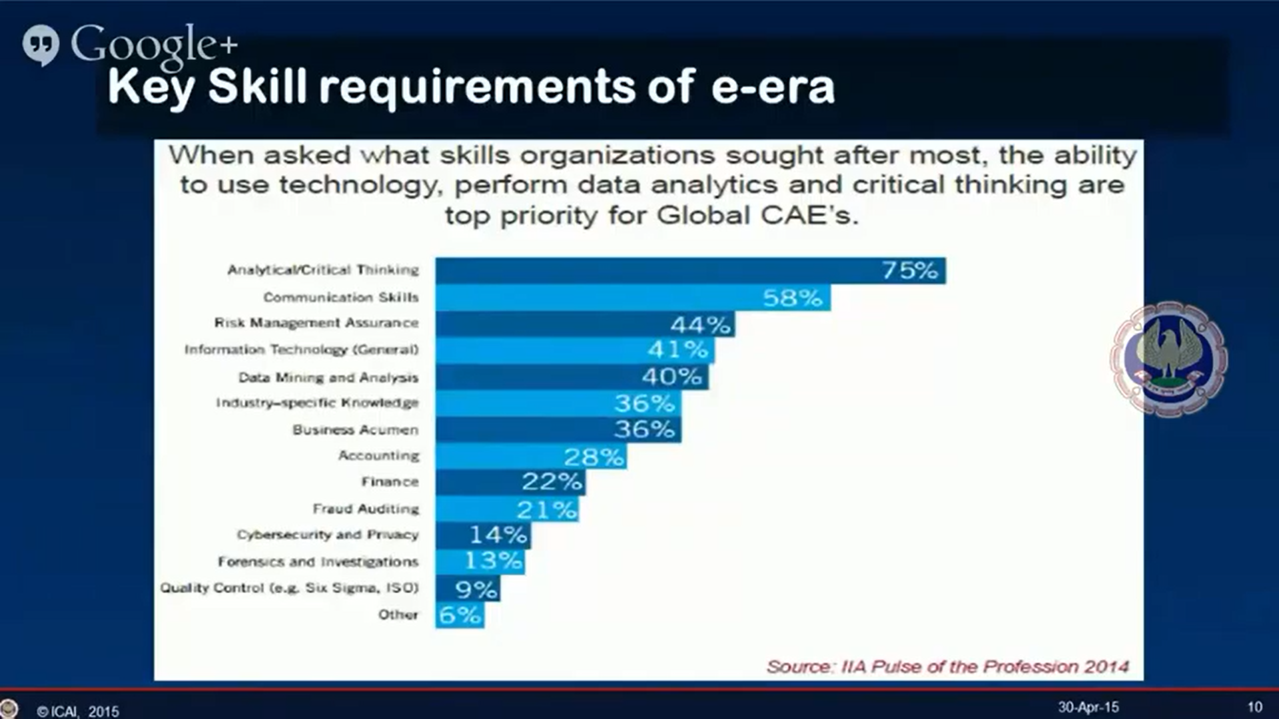
Key Skill requirment of E-Era

Slide 13
80 % of Internal Audit is related to Technology

Slide 14
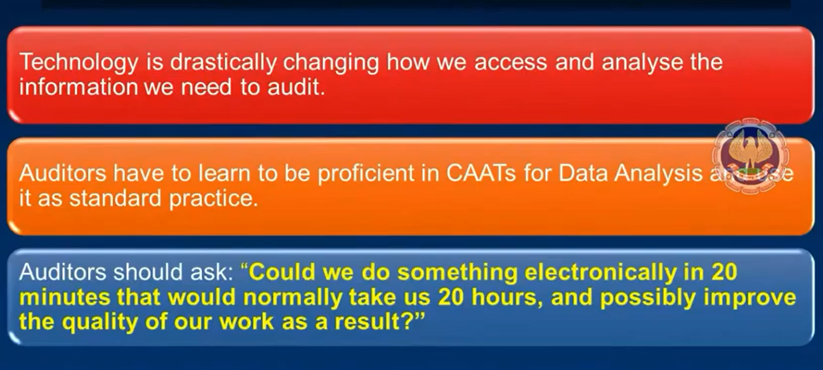
Impact of caats on auditors

Slide 15
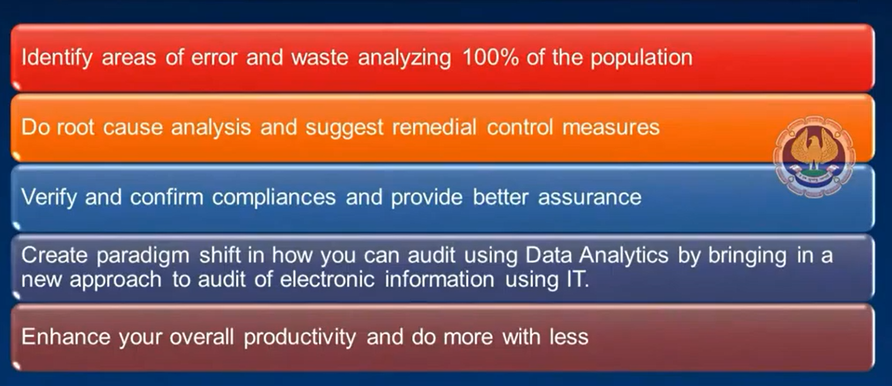
US Air force find over $1.4 billion using data analysis

Slide 16
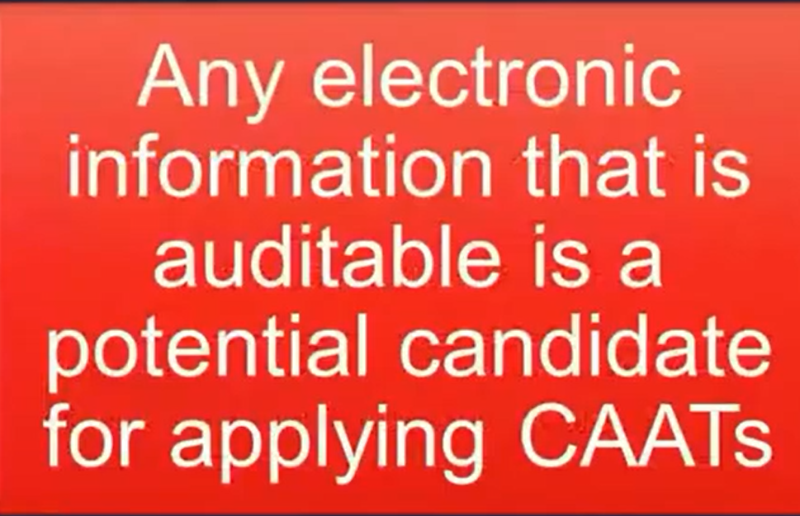
When to use caats ?

Slide 17
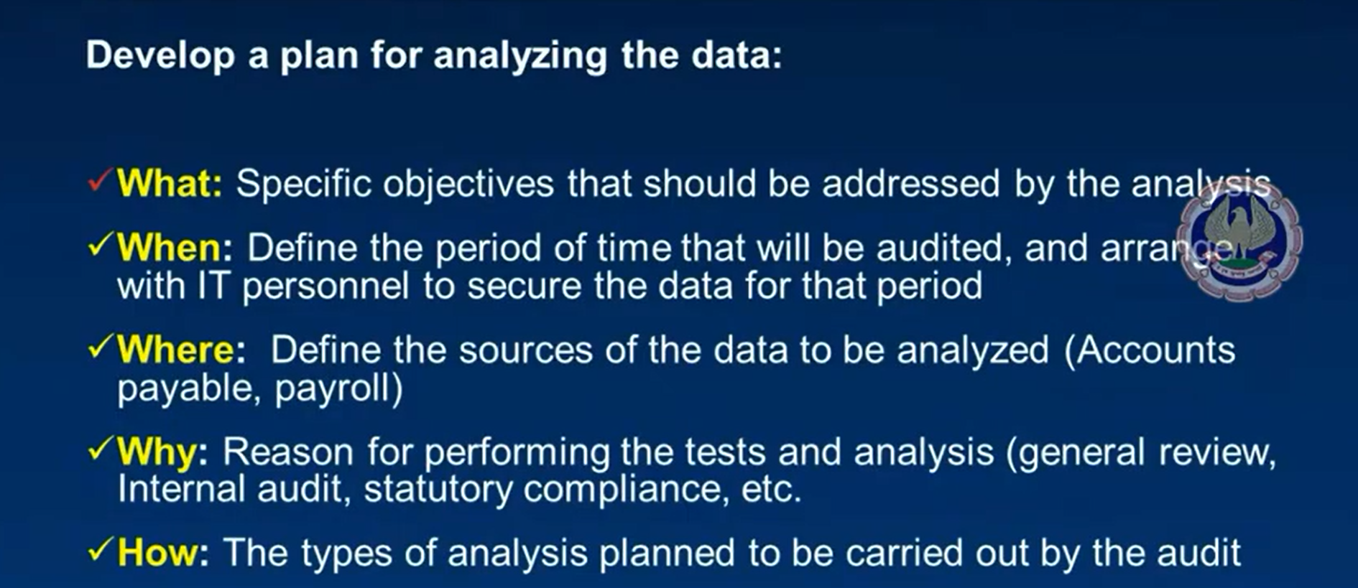
How :Step & Approaches

Slide 18
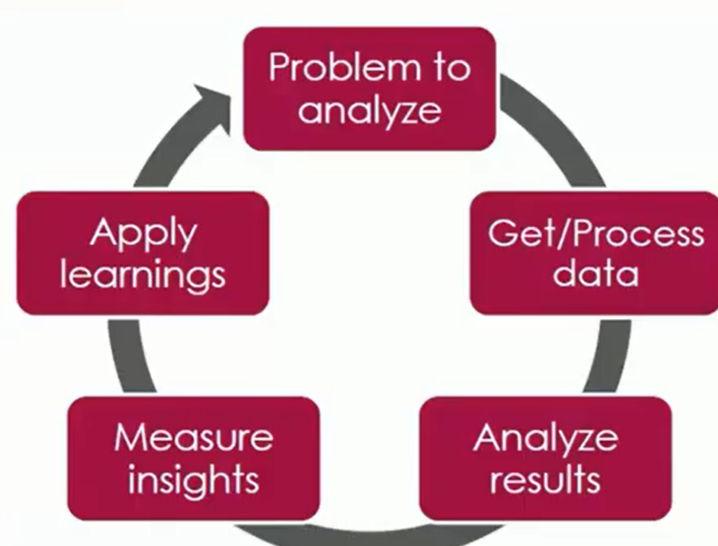
Approache to using caats

Slide 19
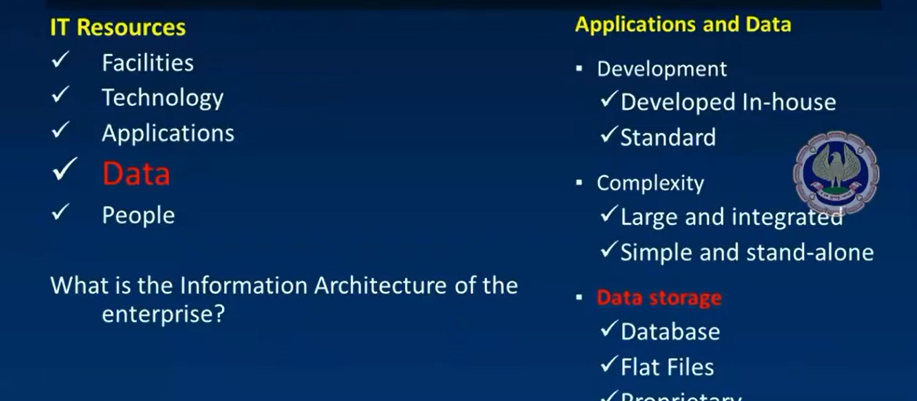
Understand it environment, application and data

Slide 20
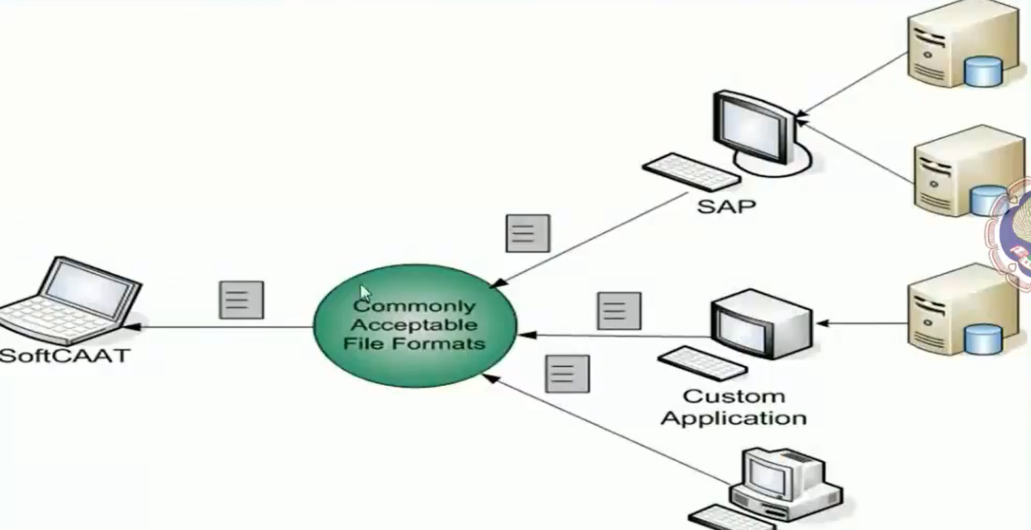
How to use caats

Slide 21
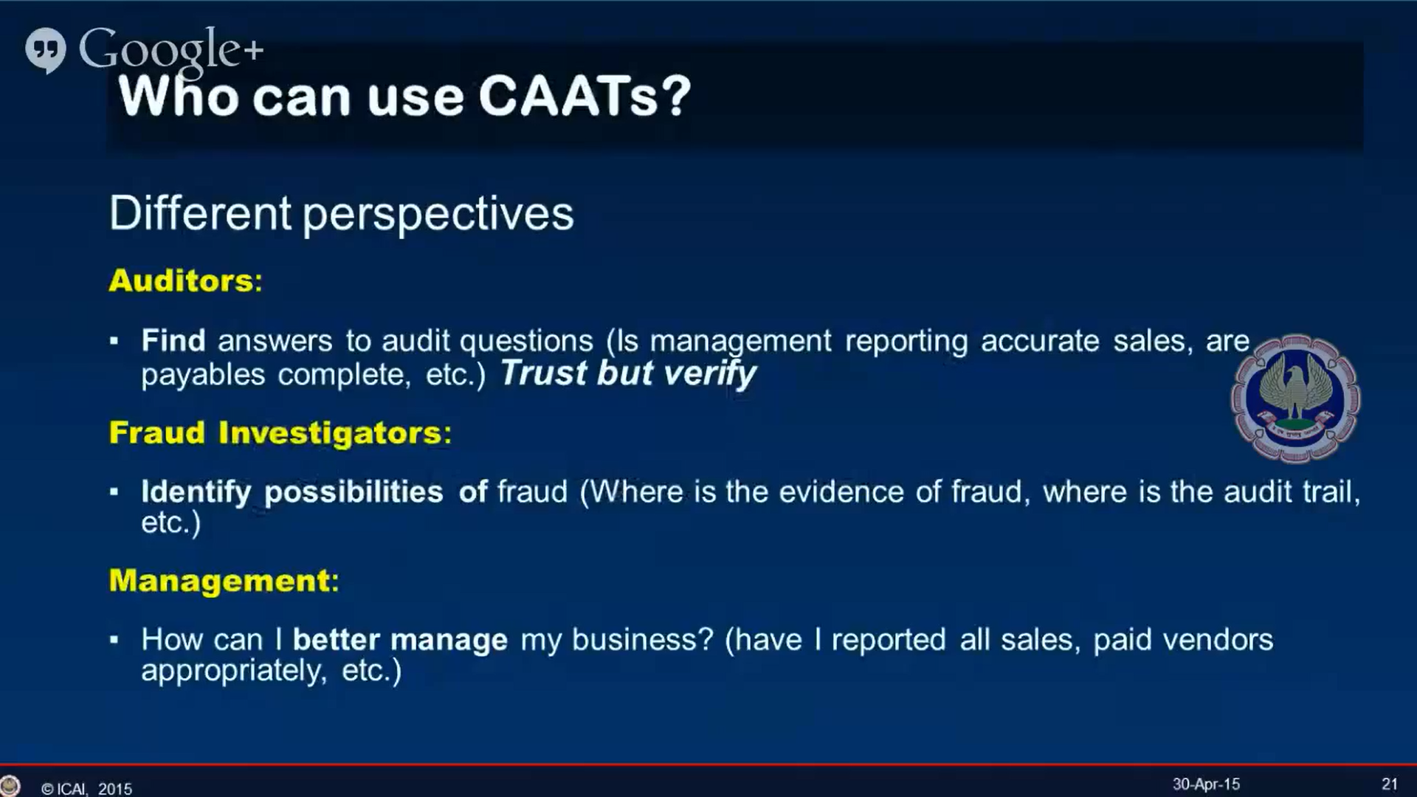
Who can use caats

Slide 22
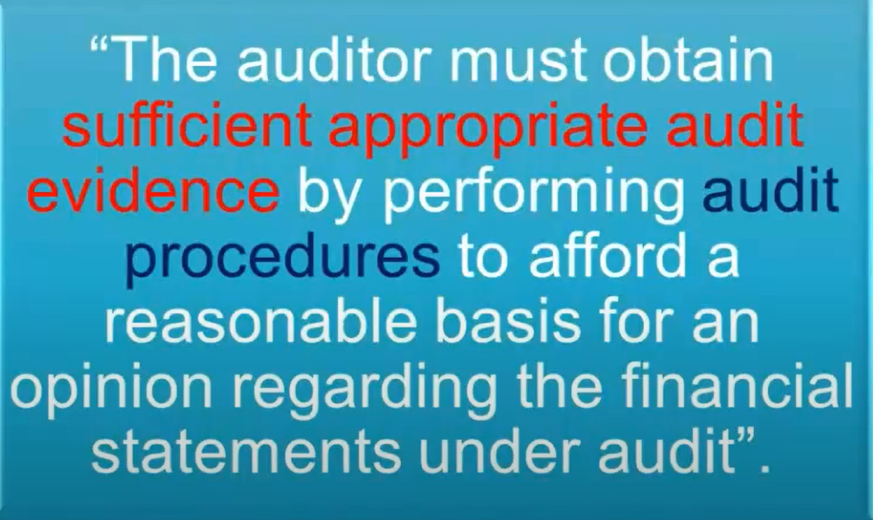
Audit Evidence

Slide 23
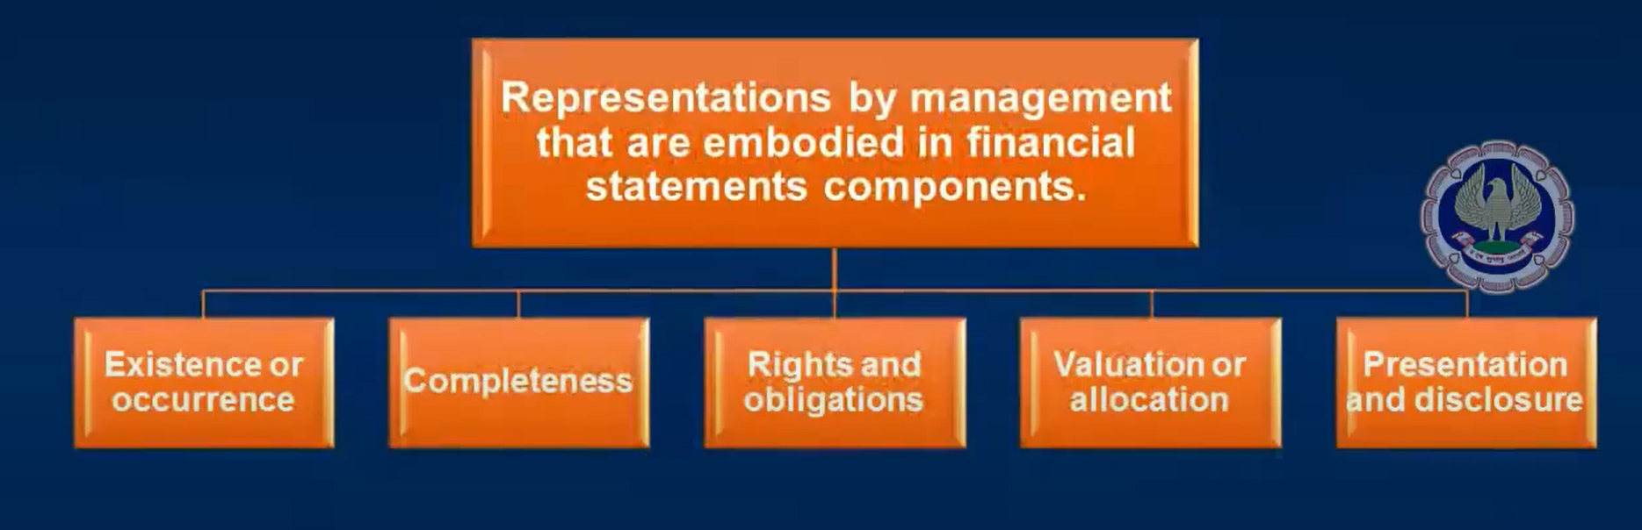
Categories of assertions

Slide 24
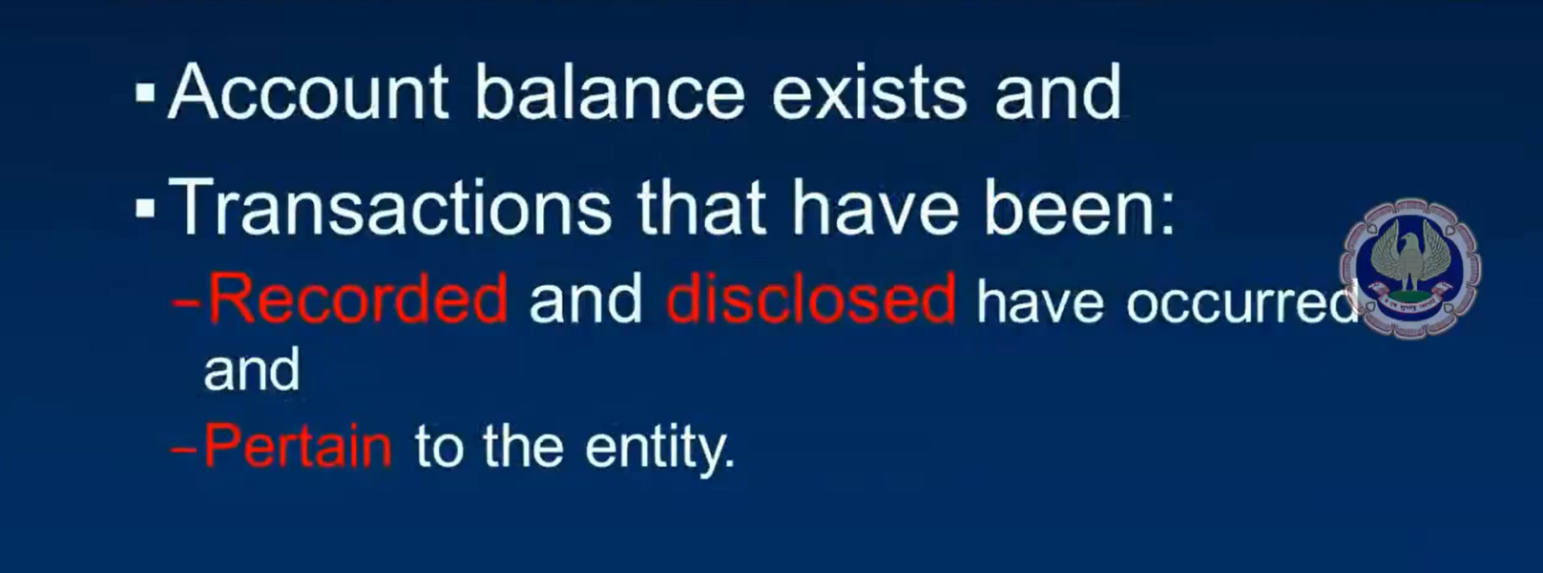
Existence & occurence

Slide 25
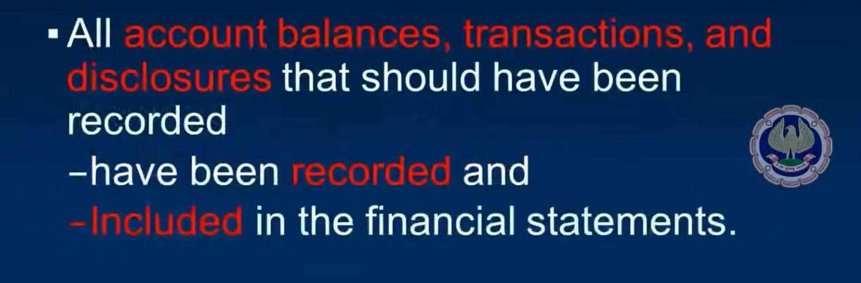
Completeness

Slide 26
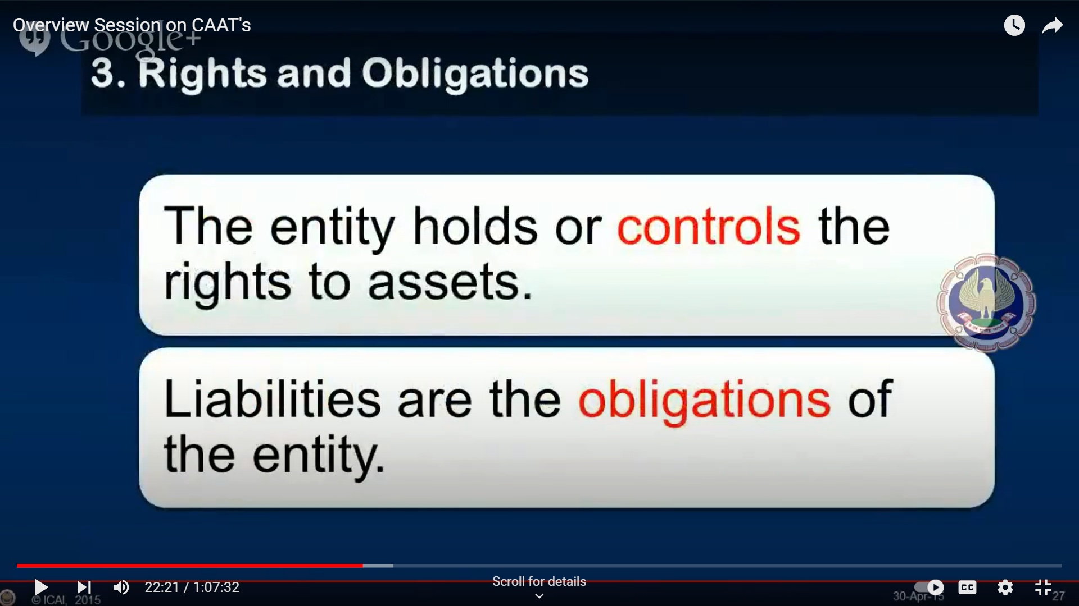
Rights and obligations

Slide 27
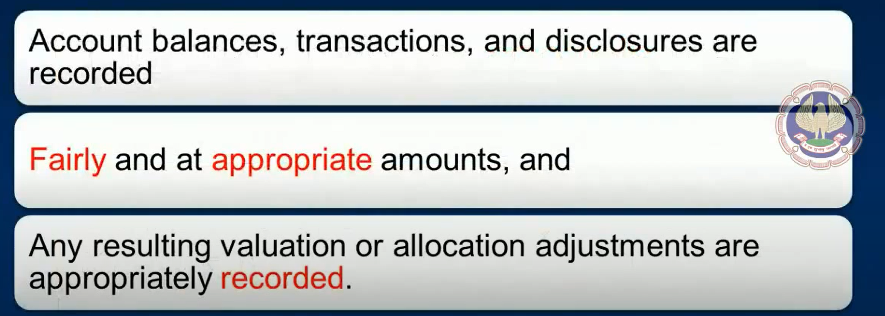
Valuation Allocation and Accuracy

Slide 28
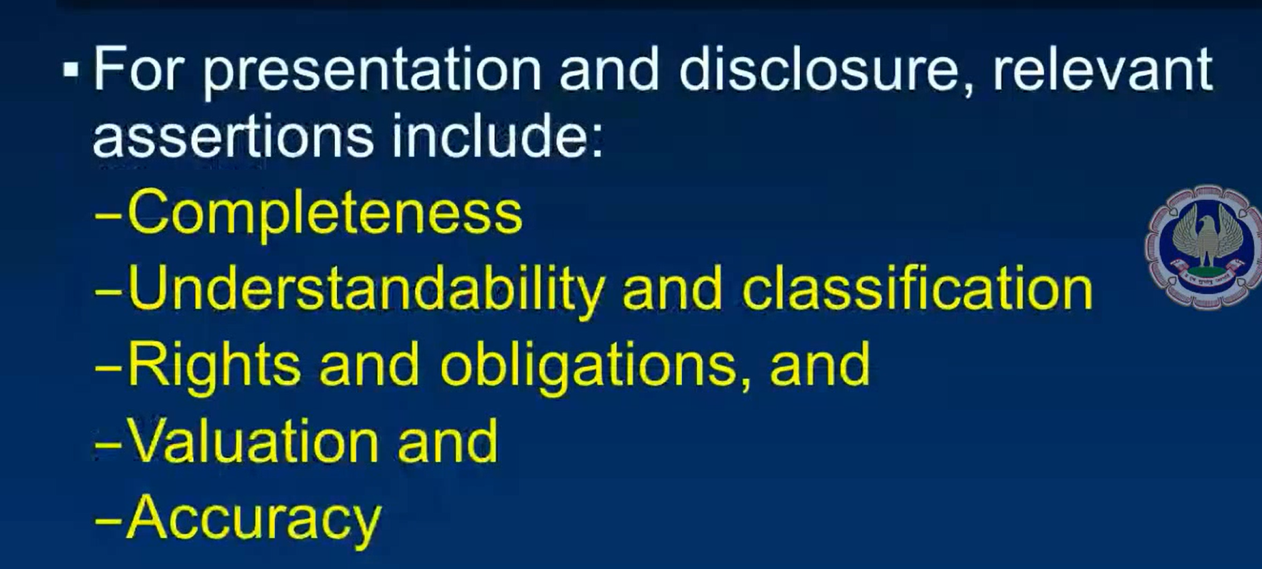
Presentaion & Discolsures

Slide 29
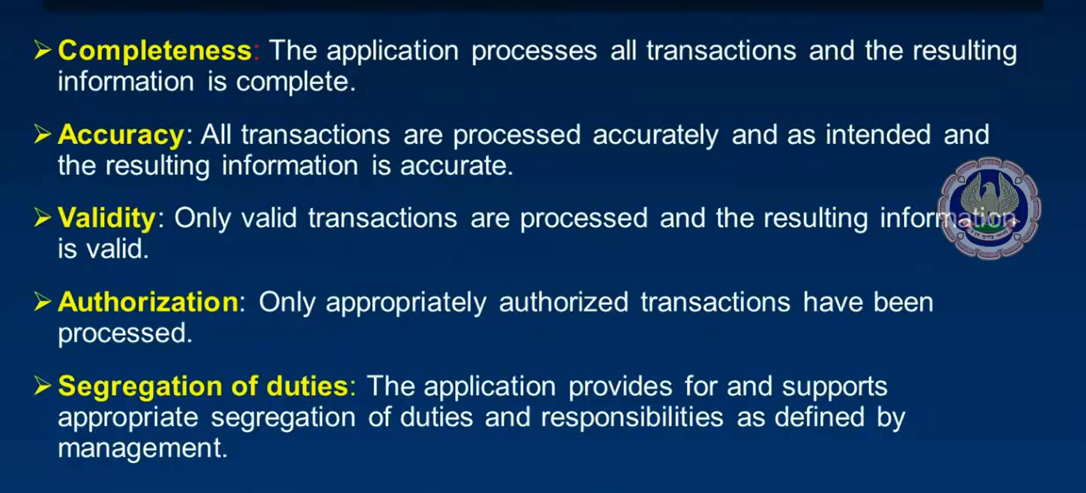
Application Control objective

Slide 30
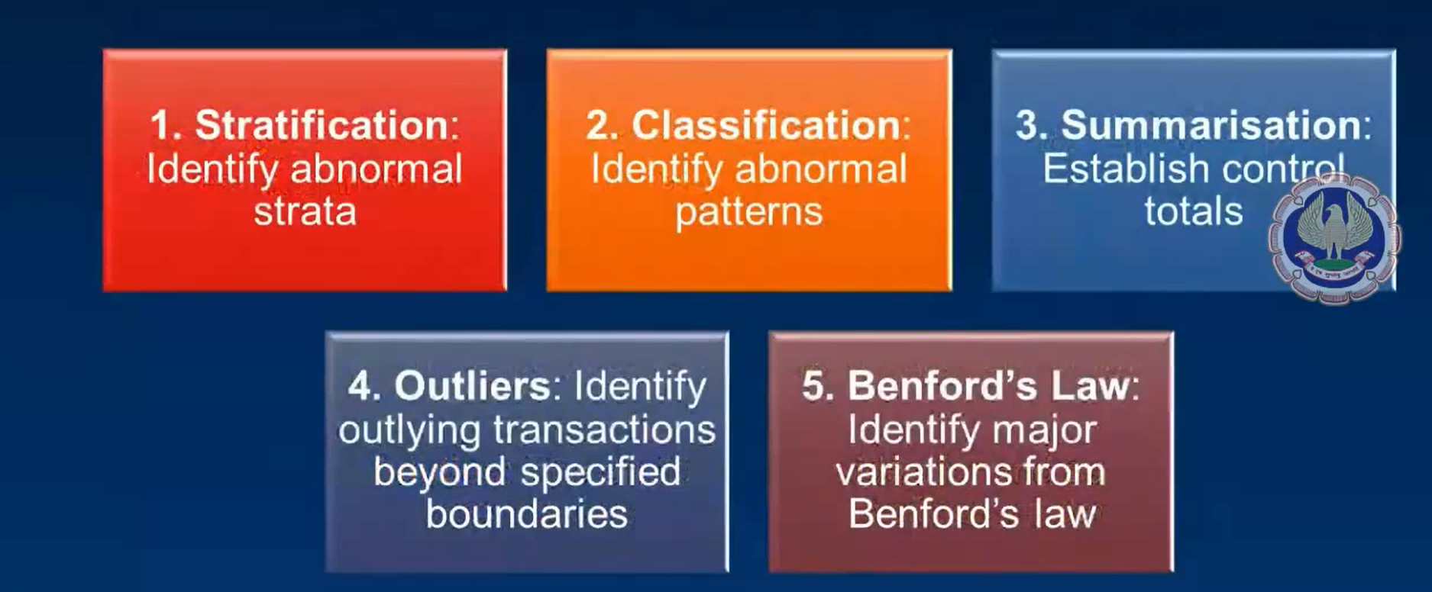
Key Feature of Caats

Slide 31
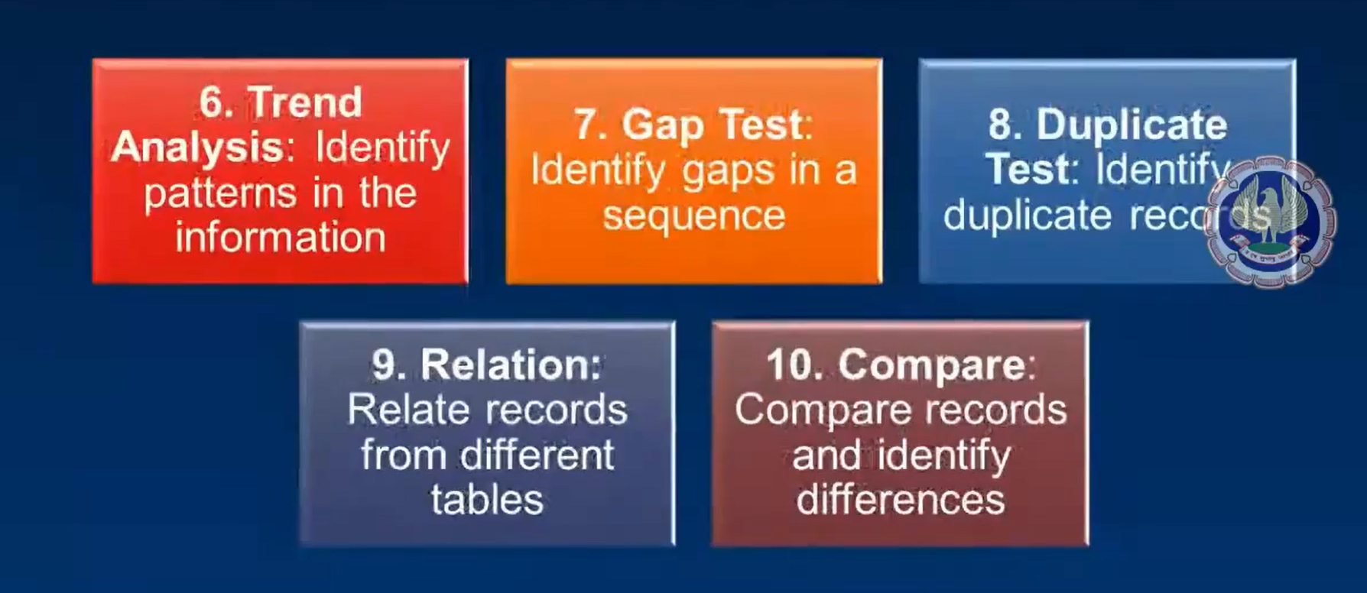
Key Feature of Caats

Slide 32
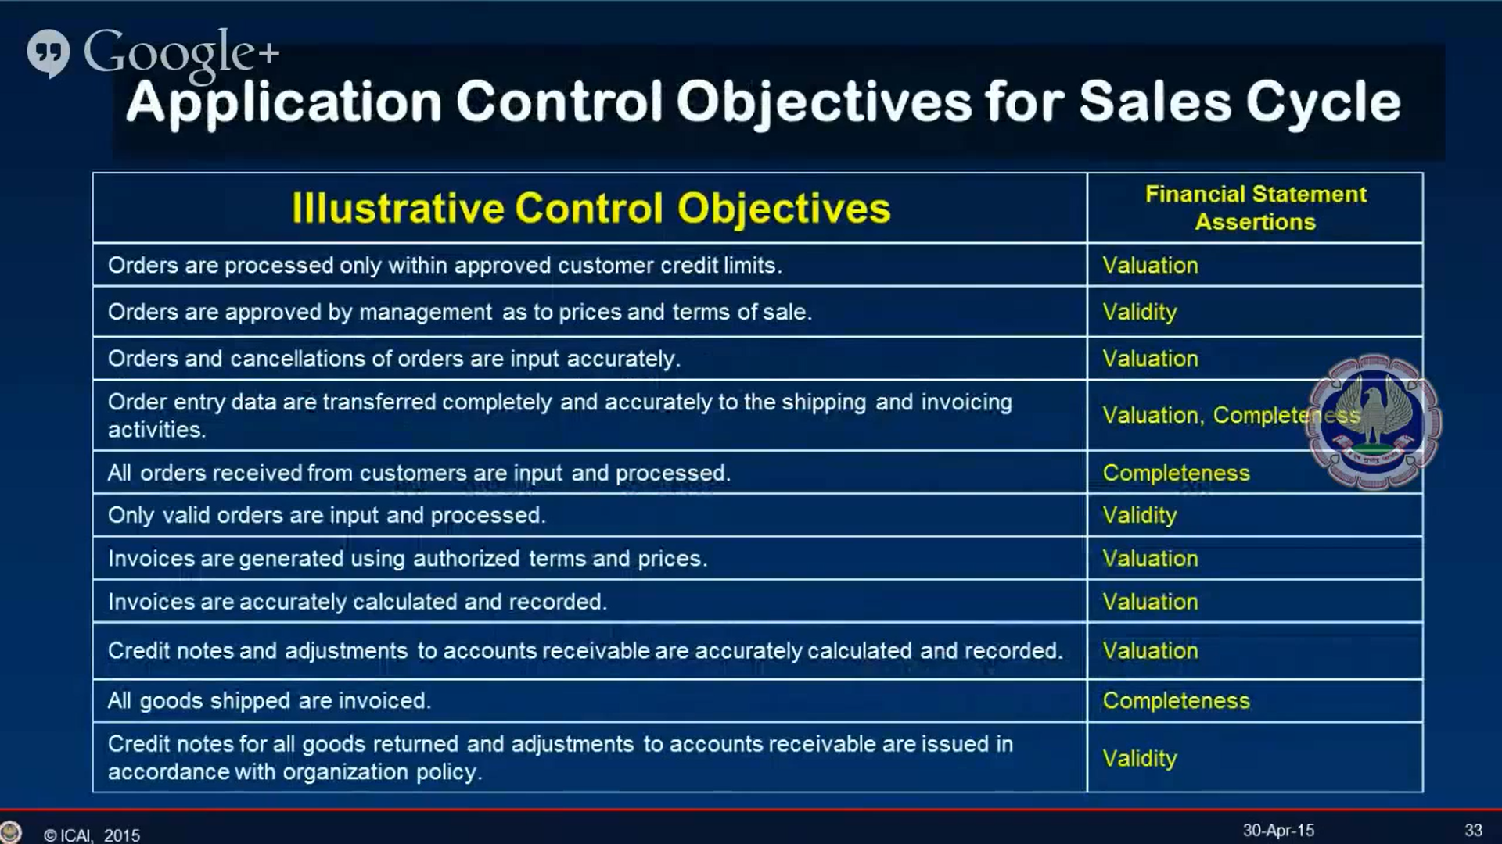

Slide 33
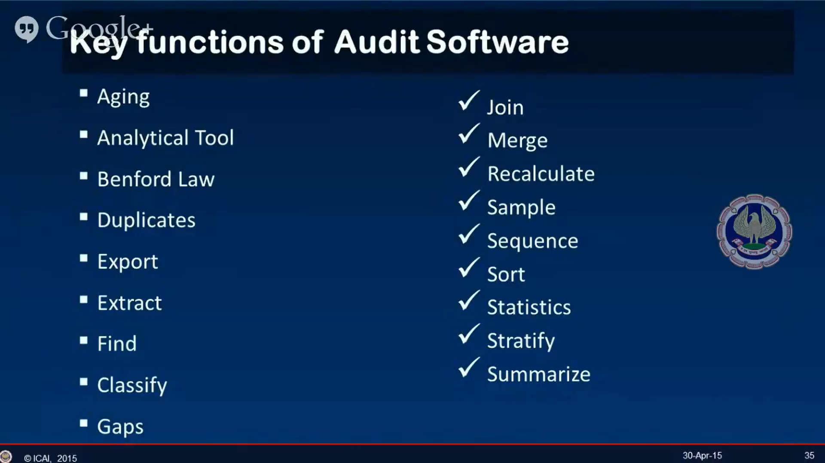
Key Function of Audit Software

Slide 34
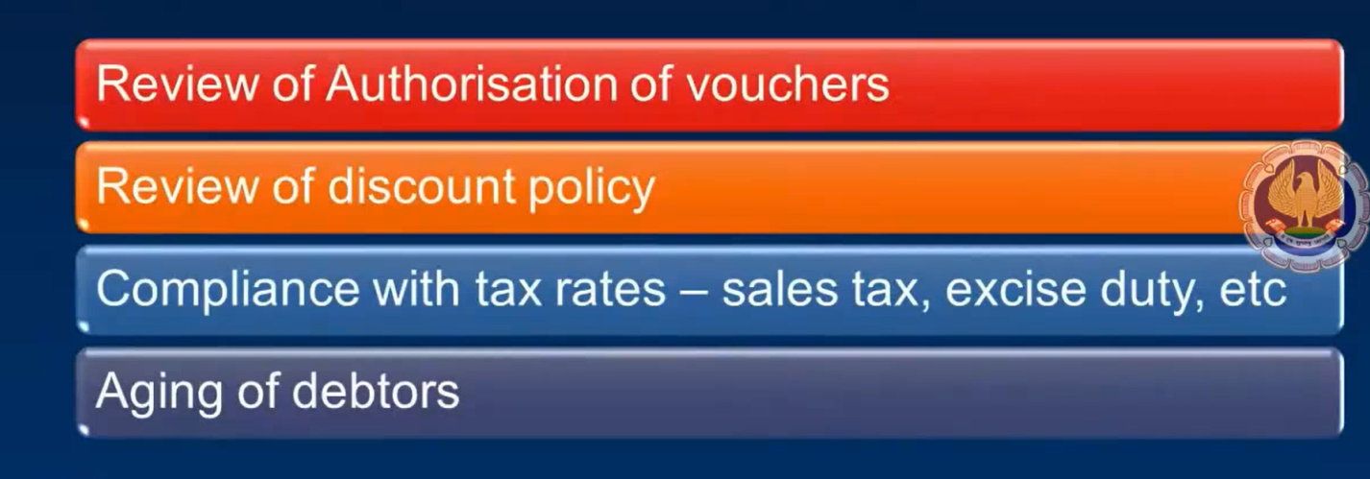
Case study : financial audit

Slide 35
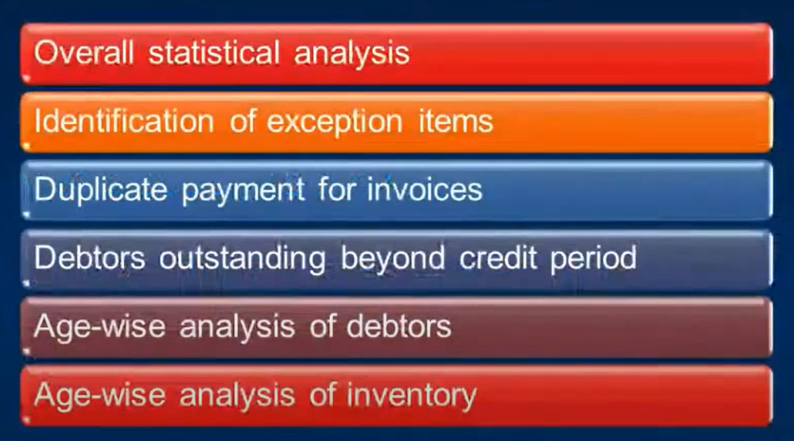
Case study 2: internal audit

Slide 36
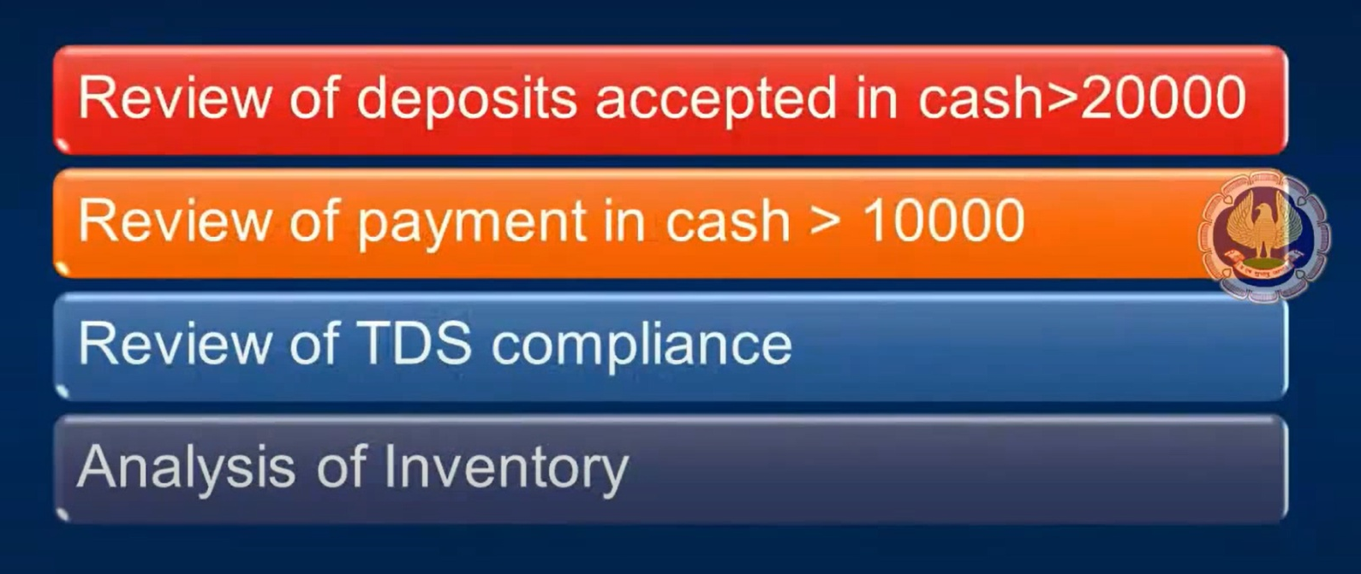
Case study 3: tax audit

Slide 37
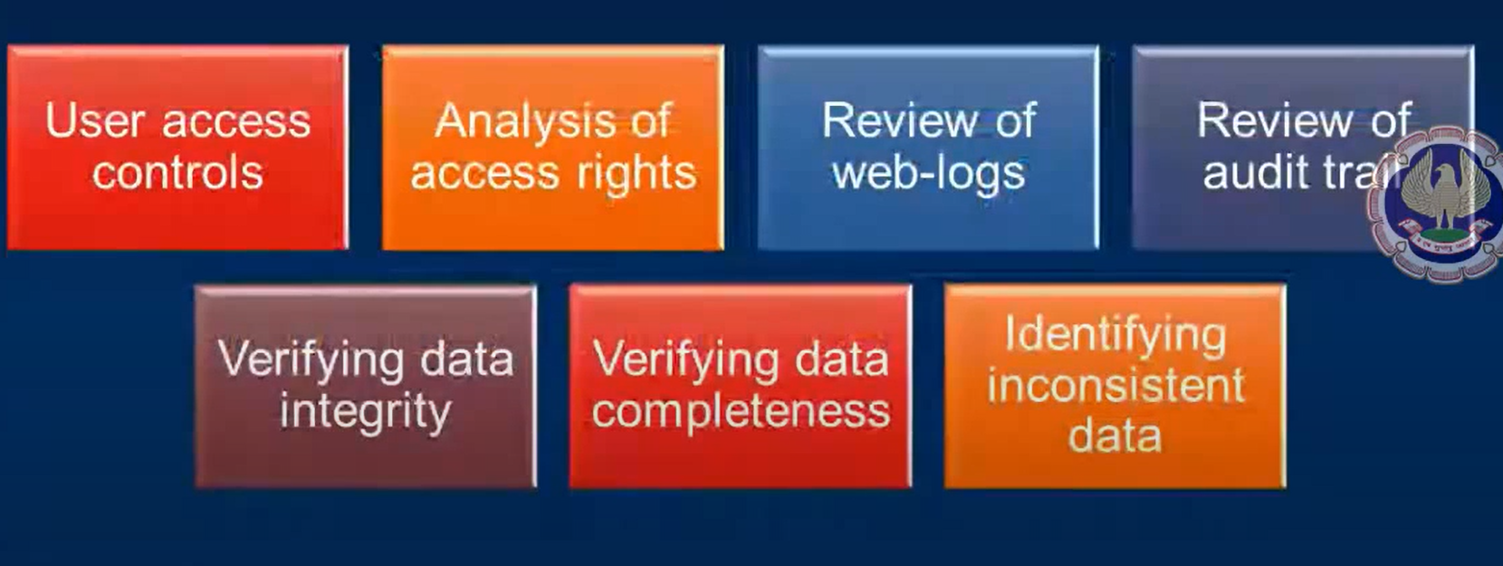
Case study 4: is audit

Slide 38
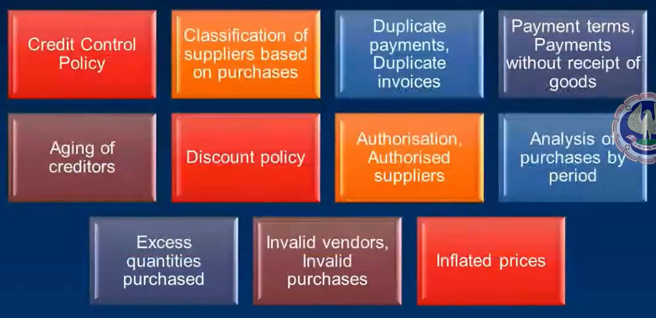
Case Study 5: Purchases

Slide 39
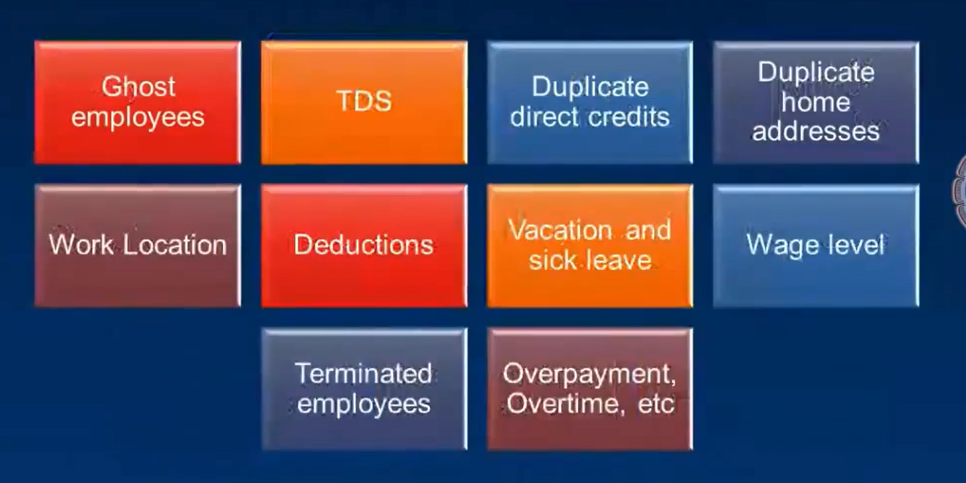
Case study 6: fraud in payroll

Slide 40
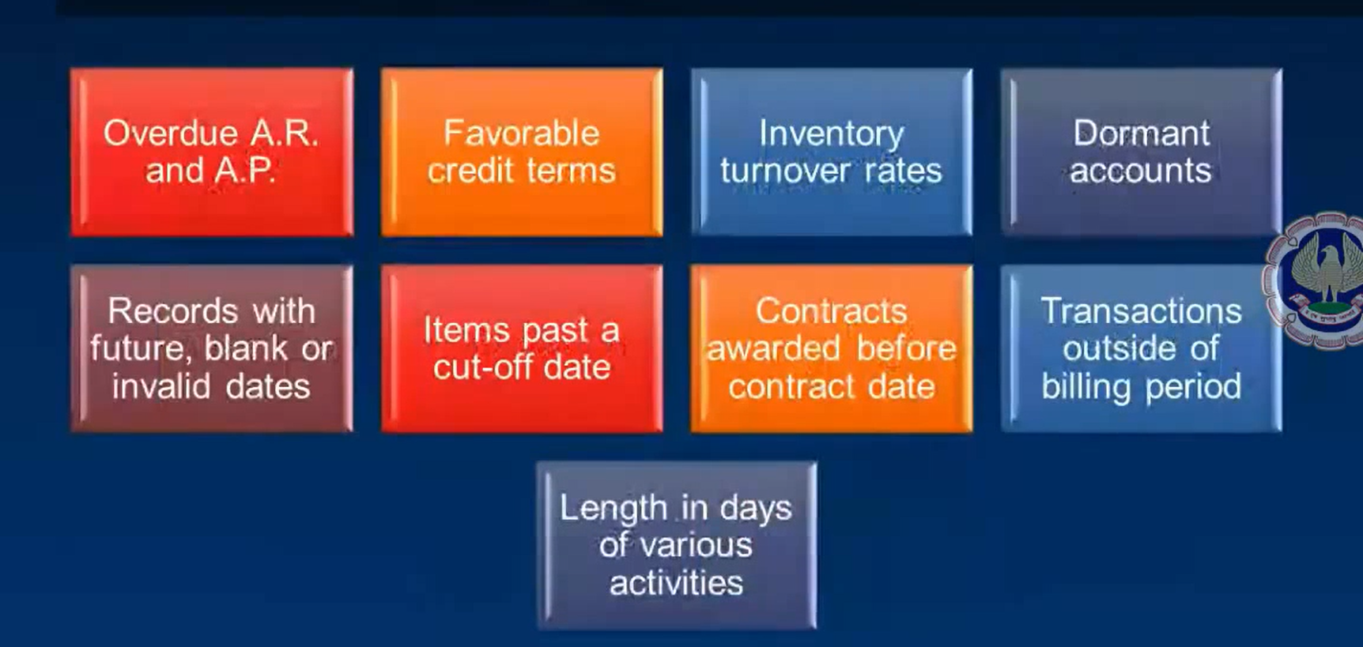
Case Study 7: Aging

Slide 41
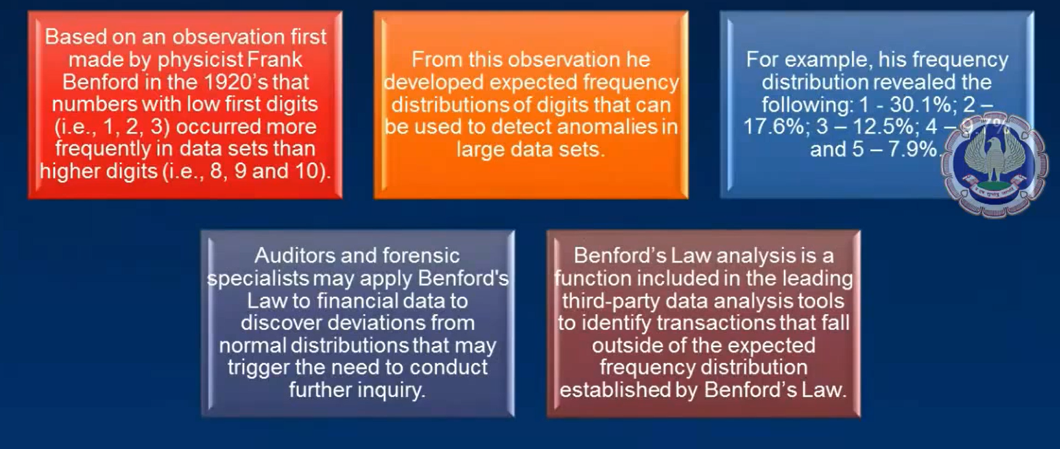
Benford’s law

Slide 42
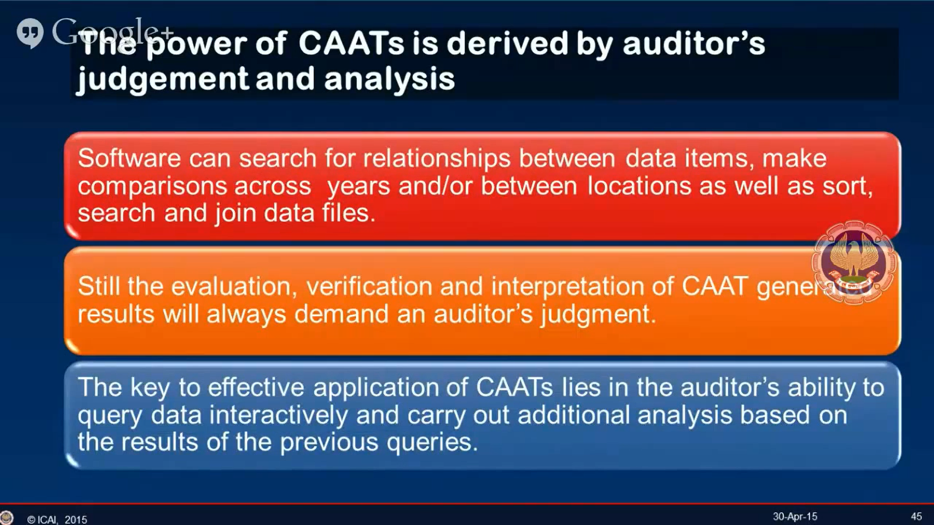

Slide 43
Myths
 Too expensive.
 Highly technical, complex.
 Only for use by IS auditors.
 Hands-on approach to auditing.
 Compromised systems and data.

Slide 44
Benefits
"The use of Computer Assisted Audit Techniques (CAATs) provide an effective means to increase our audit coverage while decreasing the risks and costs of auditing certain financial services systems and/or accounts.“

Slide 45
Benefits
 Scoping & Planning
 Increased Coverage
 Better Use of Auditor Resources
Improved Results
Reduced Costs
 Increased Performance
 Increased Analytical Capabilities

Slide 46
OBTAINING AUDIT DATA
copy of data in their original format for independent analysis.
The data has to be obtained in commonly accepted format.
If the data is a native format which is not readable by audit software, then it is necessary
to export this data to commonly recognizable format of audit software.

Slide 47
KEY STEPS FOR OBTAINING DATA
1. Discuss with client about the requirement of raw data for audit and issue a request letter for getting the requested data in specifi ed form as per the audit objectives.
2. Discuss with the IT personnel responsible for maintain data/application software and
obtain copies of record layout and definitions of all fields and ensure that you have an
overall understanding of the data. The record layout should describe each field and provide information about the starting and ending positions and the data type (numeric, alphanumeric, character, etc.).
3. Print sample list of the first 100 records in the data fi e and compare this to a printout of the obtained data to confirm they are correct
4. Verify data for completeness and accuracy by checking the field types and formats, such as
identifying all records with an invalid date in a date field.
5. Obtain control totals of all the key data and compare with totals from the raw data to ensure
all records have been properly obtained. This can be performed by importing the data in audit
software and reviewing the statistics of all the key fields.

Slide 48
Precautions in using CAATs
1. Identify correctly data to be audited
2. Collect the relevant and correct data fi les
3. Identify all the important fi elds that need to be accessed from the system
4. State in advance the format the data can be downloaded and defi ne the fi elds correctly
5. Ensure the data represent the audit universe correctly and completely.

Slide 49
Precautions in using CAATs
6. Ensure the data analysis is relevant and complete.
7. Perform substantive testing as required.
8. Information provided by CAATs could be only indicators of problems as relevant and perform
9.detailed testing as required.

Slide 50
STEP BY STEP METHODOLOGY FOR USING CAATs
Identify the scope and objectives
Identify the critical data
Identify the sources of data
relevant personnel responsible
Obtain and review documents
walk-through
Decide the techniques
Prepare a detailed plan
Perform relevant tests

Slide 51
EXAMPLES OF TESTS PERFORMED USING CAATs
Identify exceptions
Identify exceptional transactions based on set criteria. For example, cash transactions above Rs. 20,000
Analysis of Controls
Identify whether controls as set have been working as prescribed. For example, transactions are entered as per authorized limits for specified users
Identify errors
Identify data, which is inconsistent or erroneous. For e.g.: account number which is not numeric.

Slide 52
EXAMPLES OF TESTS PERFORMED USING CAATs
Statistical sampling
Perform various types of statistical analysis to identify samples as required.
Detect frauds
Identify potential areas of fraud. For example, transactions entered on weekdays or purchases from vendors who are not approved
Verify calculations
Re-perform various computations in audit software to confirm the results from application software confirm with the audit software. For e.g.: TDS rate applied as per criteria.

Slide 53
EXAMPLES OF TESTS PERFORMED USING CAATs
Existence of records
Identify fi elds, which have null values. For example: invoices which do not have vendor name.
Data completeness
Identify whether all fields have valid data. For example: null values in any key field such as date, invoice number or value or name
Data consistency
Identify data, which are not consistent with the regular format. For example: invoices which are not in the required sequence.

Slide 54
EXAMPLES OF TESTS PERFORMED USING CAATs
Duplicate payments
Establish relationship between two or more tables as required. For example duplicate payment for same invoice
Inventory obsolescence
Sort inventory based on data of purchase or categories as per specified aging criteria or period and identify inventory which has become obsolete
Accounts exceeding authorized limit
Identify data beyond specifi ed limit. For example, transactions entered by user beyond their authorized limit or payment to vendor beyond amount due or overdraft allowed beyond limit.

Slide 55
Potential Problems
 Incorrect identification of audit population.
 Improper data requirements.
 Invalid analysis.
 Failure to recognize opportunity.

Slide 56
ANALYTICAL REVIEW PROCEDURES
Analytical procedures include the consideration of comparisons of the entity’s financial
information with, for example:
● Comparable information for prior periods.
● Anticipated results of the entity, such as budgets or forecasts, or expectations of the auditor, such as an estimation of depreciation.
● Similar industry information, such as a comparison of the entity’s ratio of sales to accounts receivable with industry averages or with other entities of comparable size in the same industry
Most of the analytical procedures can be performed in an IT environment using CAATs which makes the audit process much more effective and efficient.

Slide 57
SUMMARY
CAATs enable auditors to use computers as a tool to audit electronic data.
CAATs provide auditors access to data in the medium in which it is stored, eliminating the boundaries of how the data can be audited. As auditors start using CAATs, they will be in a better position to have a considerable impact on their audit and auditee as more time is spent on analysis and less time on routine verification.
It is important to understand the client IT environment and chart out which techniques of CAAT could be used. Initially, time needs to be invested in this Endeavour but once the audit plan is prepared based on the IT environment as per audit scope, re-use becomes easier. However, the audit plan and tests need to be updated based on changes in the IT environment as relevant.
Using CAATs provides greater assurance of audit process to the auditor and also to the auditee.
The key to using CAAT is recognizing the need, learning how to use CAATs and using them in practical situations.

Slide 58
Are you Ready to move from Ticks to Clicks ?
CAAT –AUDIT TOOLS FOR DIGITAL DECADES
Where ever there is mouse,
there is CAAT

Slide 59
-:THANK YOU:-
|| ॐ सर्वे भवन्तु सुखिनः , सर्वे सन्तु निरामयः
सर्वे भद्राणि पश्यन्तु, मा कश्चिद दुखभाग भवेत्. ||
May all be happy. May all enjoy health and freedom from disease.
May all have prosperity and good luck. May none suffer or fall on evil days
.

