Slide 1
DETECTION OF FRAUD WITH CAATS
ICITSS Course
© The Institute of Chartered Accountants of India

Slide 2
Identify Transaction
Inquire and understand the Business Systems and processes relevant for the business entity
Understand, evaluate and test the internal controls for passing journal entries.
Inquire and understand the fraud risk factors relevant for the business entity
The auditor should make enquiries from personnel across the hierarchies on unusual activities
Assess whether the unusual activities pertain to journals etc.
Identify and assess the journal entries

Slide 3
Identify Transactions
Understanding business system and processes
Fraud risk factors
Sales targets to be achieved – important to investors, stock holders etc.
Debt requirements – banks etc.
Bonuses and incentives – employees
Accounting software – ERP/customised/off the shelf packages
SA/SOD among IT and business teams etc.
Type of entries – automated or manual etc.
IT team – in house/outsourced
Timing of passing journal entries – end of day, weekend etc.

Slide 4
Identify Transactions
Ask open ended questions
Whether the employee who recorded entries went on vacation and if there was a substitute during that period
Whether the employee shared his user id and password with any person during the year.
Whether any entries were passed during the year without any supporting documents.

Slide 5
Completeness of Data
Understand the timing of extraction of Journal Entries
Books of accounts should be closed for the period
For any addition entries, a separate tracker to be maintained for entries that may be passed later
In cases of testing prior to year end, the auditor should keep track of all entries passed subsequently and analyse them later.

Slide 6
Completeness of Data
Data fields to be extracted
Date
AccountNumber
JournalNo.
AccountName
JournalType
Description
EntryDate
DebitAmount
Creditamount
Approveddate
Posteddate
Lineno.
Period
Preparedby
BusinessUnit
Approvedby
Postedby

Slide 7
Completeness of Data
Methods to test completeness of data
Roll forward Testing
Other methods
Roll forward the entries passed during the year to the balances in the Trial Balance. The auditor may use ACL/IDEA Caseware/MS Access/Excel etc.

Slide 8
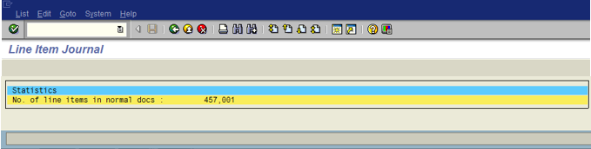
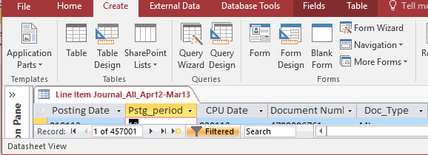
Completeness of Data
Example

Slide 9
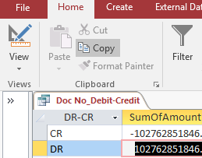
Completeness of Data
If the company is using an ERP, then, the auditor can ask for a full list of entries based on Journal type and summarise the data based on Journal type. This can be reconciled with the Trial Balance and tested for completeness.
Details | Opening balance | Debits | Credits | Closing Balance
Balance Sheet
Cash balance | 10000 | 2000 | 4000 | 8000
Profit & Loss
Salaries | 0 | 50000 | 2000 | 48000

Slide 10
Completeness of Data
There are industries/sectors where the roll forward testing may not be appropriate or feasible.
For example - in banks/financial institutions/e-commerce/retail sectors where the volume of transactions are huge, the auditor may have to think of a different method to test for completeness of data.
Identify the key account balances and perform roll forward testing only for those accounts and not for all accounts.
High risk accounts such as - intercompany accounts and related party transactions - Reconcile the opening balances and closing balances with previous year and current year financial statements and then test by roll forward the transactions (debit and credit).
Holding company audits – A holding company with many subsidiaries - Journal entry testing may be very challenging. A possible path would be to adopt roll forward testing in the subsidiaries. At the holding company level, the auditor can test the consolidating and eliminating entries.
CAATS can also help in finding out gaps in the sequence numbers of journal entries. This is useful where the volume of transactions are huge such as banks/financial institutions etc.
CAATS can also help in finding out if there are duplicate journal numbers used.

Slide 11
Criteria for JE Analysis
Seldom used accounts – Accounts that are used very infrequently.
Unusual combination of accounts –
  Debit cash - Credit Revenue
Posted and approved by the same person
Persons passing entries or adjustments who generally do not pass entries
Unusual time of the day / on holidays/weekends etc.
Amounts having round numbers or same ending numbers
  Numbers ending with 0000 or 9999 etc.
Small value entries but the volume of such entries are many.
Accounts that have significant estimates or period end adjustments
Accounts identified with risk of material misstatement
Entries passed after the books have been closed. Etc.

Slide 12
Excel for Auditor
1.Vouching
2. Sampling
3.Indexing
4. Various Functions
Indirect
Sum ifs & count ifs
Interest calculation
Goal Seek
V Lookup , match function
Speak Cell Feature in Excel
. Camera Feature In Excel

Slide 13
LETS START…

